Slide 1

Which customers are most likely to churn?
Correlation of banking variables and churn rates
Marko Gerdijan

Slide 2
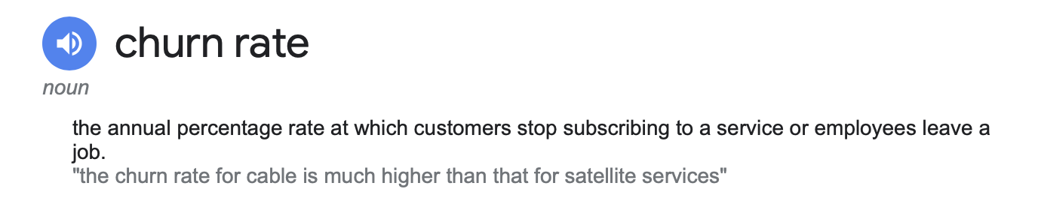
What is a churn rate?
For banks: The rate of customers that are lost

Slide 3
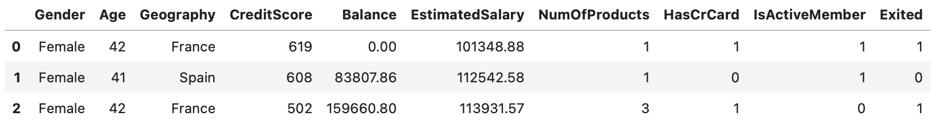
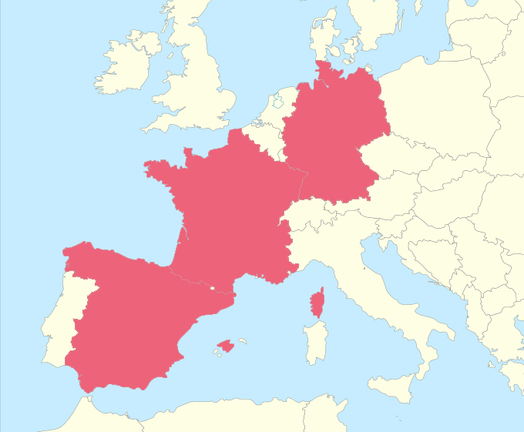
Data sneak peek
https://www.kaggle.com/datasets/hj5992/bank-churn-modelling

Slide 4
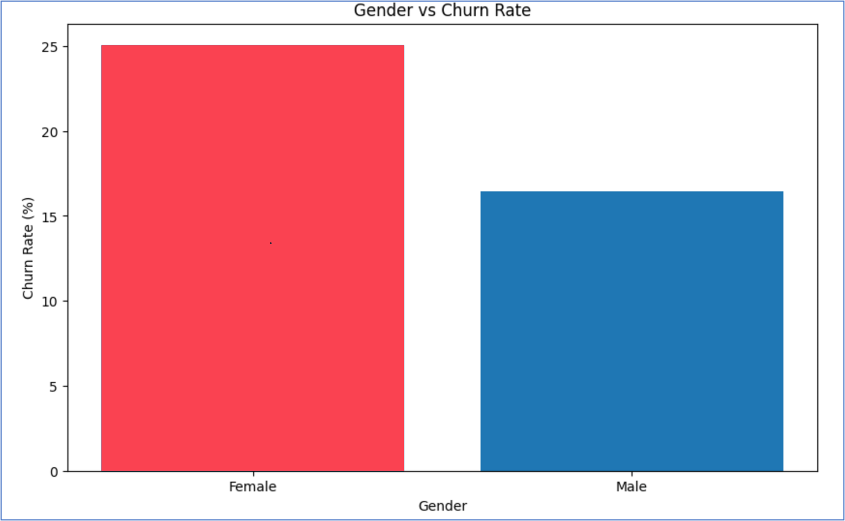

Slide 5
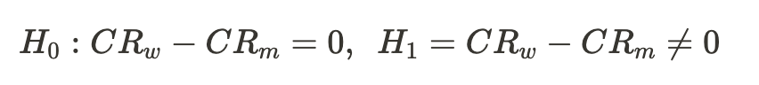
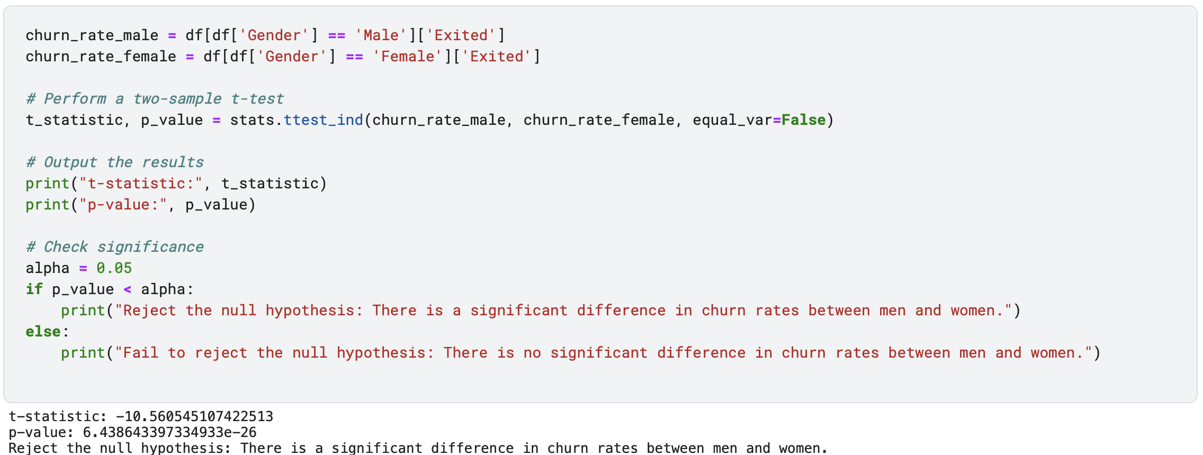
Test if there is a significant difference in churn rates for men and women

Slide 6
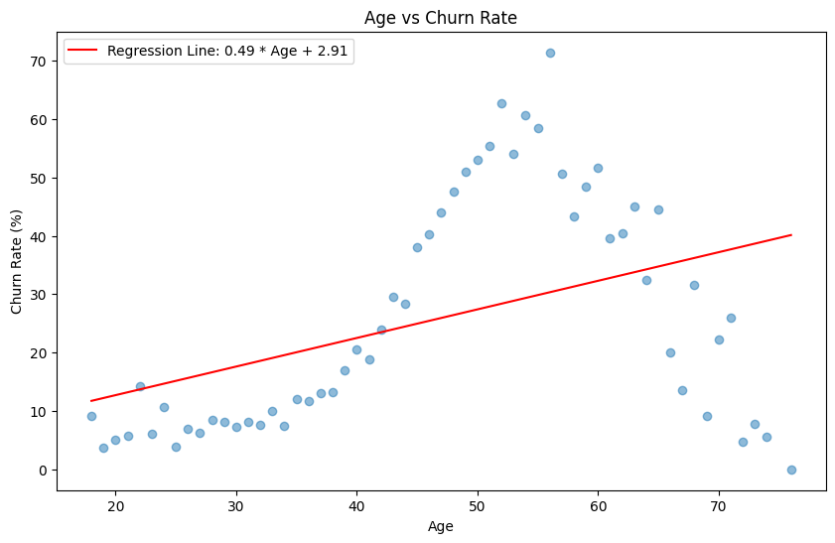

Slide 7
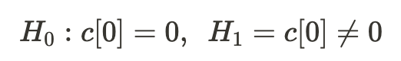
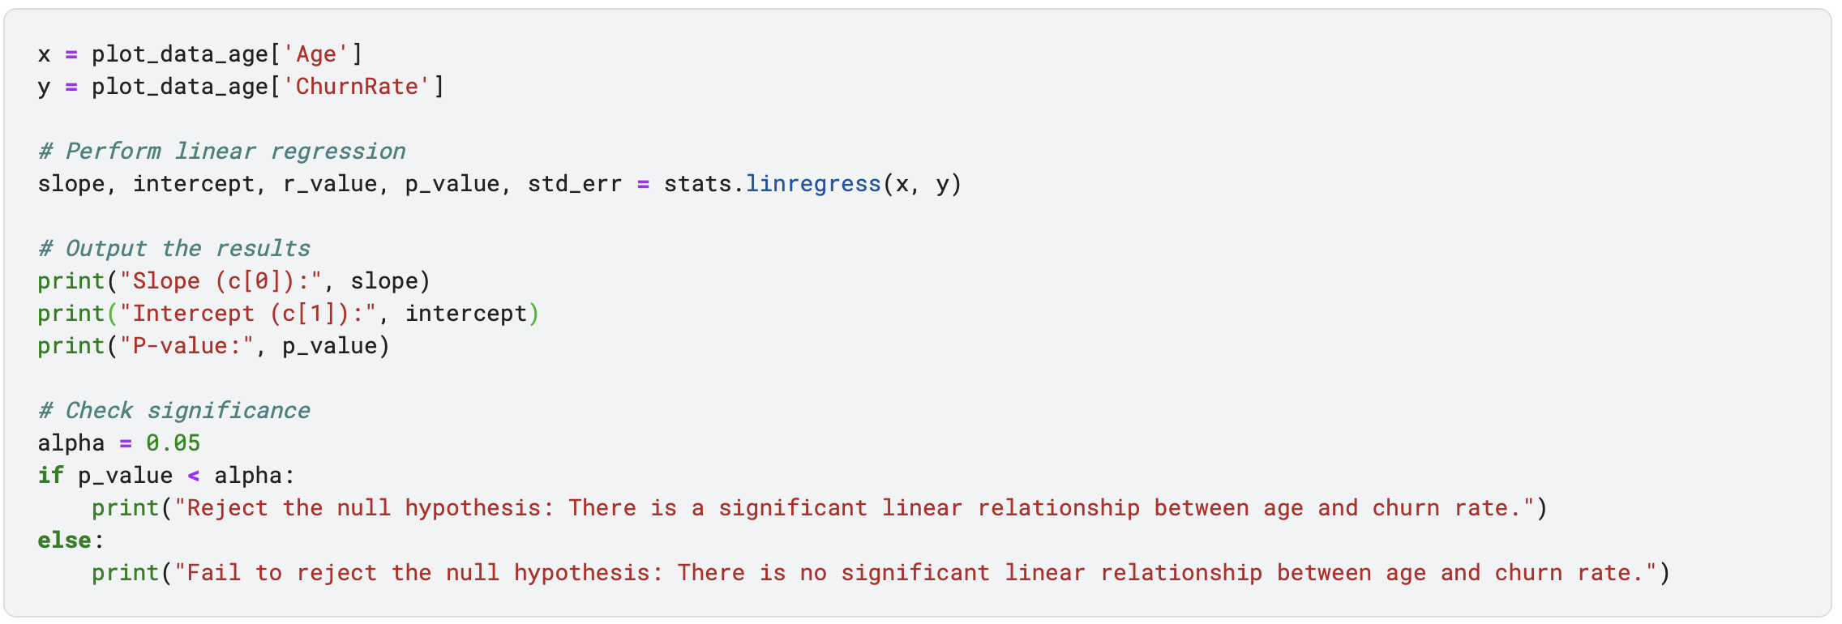
Test if there is a significant linear relationship between age and churn rate

Slide 8



Conclusion

